Slide 1
Friends
Creative Commons Attribution-NonCommercial-ShareAlike 3.0 Unported License. http://creativecommons.org/licenses/by-nc-sa/3.0/
Written by Rachel J. Morris, last updated 2016-03-05

Slide 2

Friends of Classes

Slide 3


Friends!
In C++, classes can have friends.
Friends do not belong to the class itself, but can access members of a class.
A class can have its private and protected members accessible to friend functions and friend classes.

Slide 4
Why have friends?
Maybe one class will work with another, and needs to access protected members.
We don't want to add any public functions to access these because only one other class should have access!

Slide 5
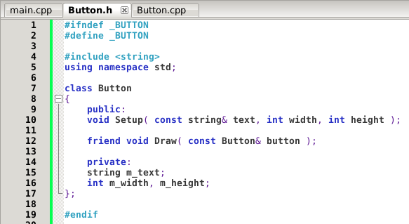
Friend functions
A Friend function can access private members of a class directly.
The Friend function can be part of another class, or just be a function independent of any objects.
Declaring a function
as a friend

Slide 6
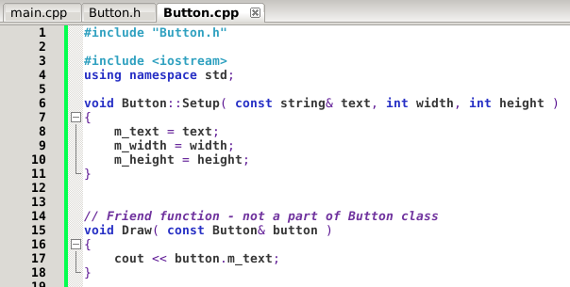
Friend functions
A friend function can be just a normal function that is not a class member
Defining the Friend function inside of the Button.cpp file. Can access private member m_text!

Slide 7
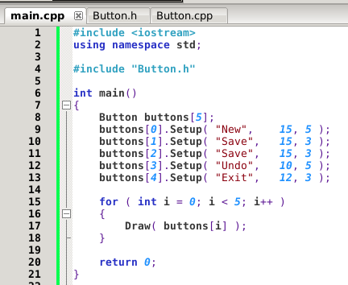
Friend functions
Call the Friend function normally, it will have access to the argument's private members.

Slide 8
Friend functions
Say we have a Fraction class. Normally when we write Fractions in math, we have something like:

Slide 9
Friend functions
If we have a Fraction class in C++, and want to multiply a second Fraction, this could be a function that belongs to the Fraction class, but it looks awkward:
Fraction.sum = fraction1.Multiply( fraction2 );
It looks a little better to have the fractions both be arguments:
Fraction.sum = Multiply( fraction1, fraction2 );

Slide 10
Friend functions
But if we create an external function to multiply two fractions
Fraction.sum = Multiply( fraction1, fraction2 );
then we'd need to add Getters & Setters for the fraction...
Set Numerator
Set Denominator
Get Numerator
Get Denominator

Slide 11
Friend functions
Instead of adding these getters/setters,
We could instead make the Multiply function a friend of the Fraction class, so Multiply can access the numerators and denominators directly.
Set Numerator
Set Denominator
Get Numerator
Get Denominator

Slide 12
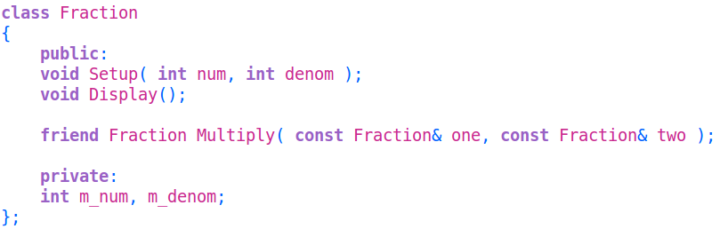
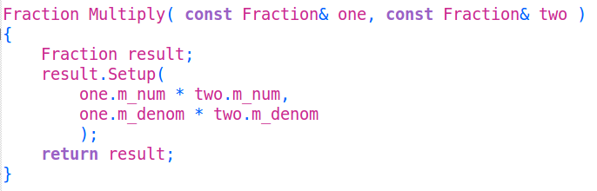
Friend functions
Within the class, we declare the function as a friend.
Outside of the class, we define the function.
Note that it is not a member of Fraction.

Slide 13
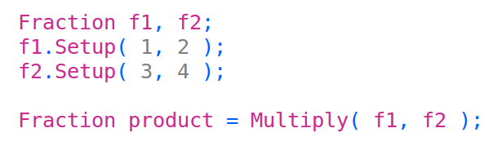

Friend functions
Now we can call it in main:
And once we get to operator overloading, we can do this instead:

Slide 14
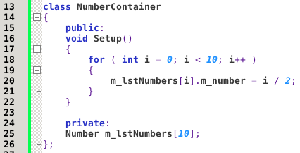
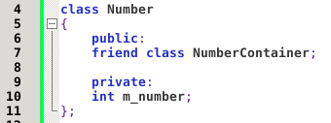
Friend classes
Besides just functions, we can make Classes friends with each other.
The Friend Class has access to the other's private members, but not vice versa.

Slide 15
Notes about friend classes
Friendships go one-way;
if class A is a friend of class B,
it doesn't automatically mean that:
class B is a friend of class A.
Friendships are not transitive
if class A is a friend of class B,
and class B is a friend of class C
it doesn't automatically mean that:
class C is a friend of class A.
Friendships are not inherited;
a child class does not inherit its parents' friends.
Access due to friendship is inherited:
If Class “Email” is a friend of “Attachment” then Email can access Attachment's members, including the members inherited by its children, through the children.
https://en.wikipedia.org/wiki/Friend_class

Slide 16
Friends!
We will see in-code examples of using friend functions in the lecture on
operator overloading

